Slide 1

Java + Mobile course by Enered

Slide 2
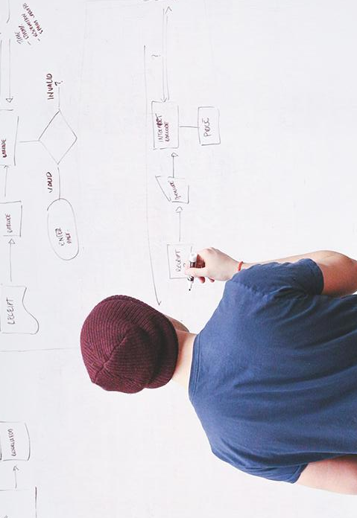
HELLO!
I am Vlad Butnaru
I will be your trainer for this Java session!
PS: It’ll be awesome!

Slide 3
What will you learn today
Primitives
Mathematical operations
Conditionals
Repetitive structures
Vectors

Slide 4
Primitives
Numerical: int, double, float, long, short
Text: String, char
Decisional: boolean

Slide 5
Naming conventions
Camel case (firstName ; lastName)

Slide 6
Mathematical operations
Addition and substraction (+;-)
Multiplication and division (*;/;%)
String concatenation (+)

Slide 7
Conditionals
> ; < ; >= ; <= ; ==
If(){}else{}
switch(a){case 1: … break; case 2: … break;}

Slide 8
Repetitive instructions
For(x; x<y; x++){}
While(x>y){}
Do{}while(x==y)
For(String word : words){}

Slide 9
Vectors
Int a[] = new int[10];
Double a[][] = new double[5][5]
String words[] = new String[100]
A[4] = 3;
A[1][2]=5.5;
Words[3] = “Java”;

Slide 10
Please open GitHub and solve the examples

Slide 11
Session review
You learned primitives
You know how to use conditionals
You know how to use repetitive instructions
You learned how to build a vector/matrix
You worked on several examples
GOOD JOB! ☺

Slide 12
THANKS!
Any questions?
You can find me at:
@web: http://vladbutnaru.com/
@facebook· Vladut Butnaru
@linkedin· Vlad Butnaru
@email : vlad2me@gmail.com
@phone : +40 0754 827 620

Slide 13
Feedback please!
http://bit.do/feedbackvlad

